Slide 2
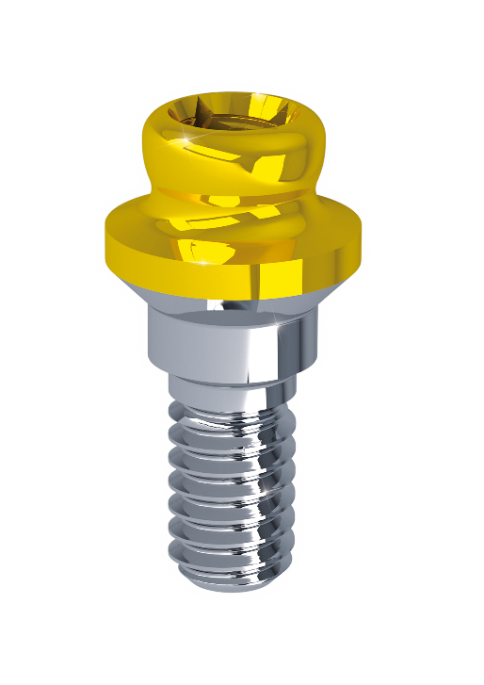
As the world changes,
small things make the difference!

Slide 3
OT Equator: Implant Retained Attachment
.
Valid International Certifications
Valid International Patent

Slide 4
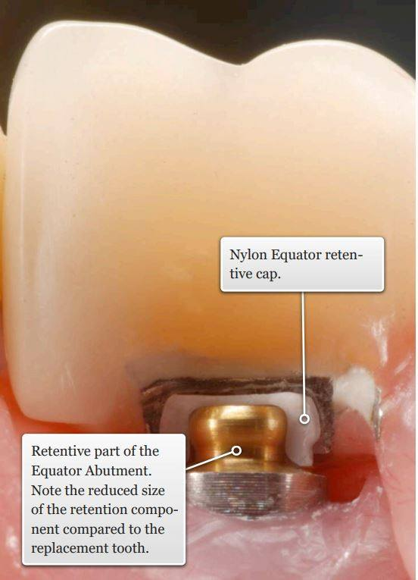
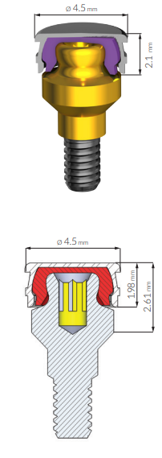
OT Equator: Technical Features
Innovative design with reduced height and diameter.
Currently the smallest attachment available in the market.
Internal thread allowing multiple applications as
passive bar connection among the dental implants.

Slide 5
OT Equator: Gingival Heights
Multiple gingival heights are available on all different implant platforms.

Slide 6
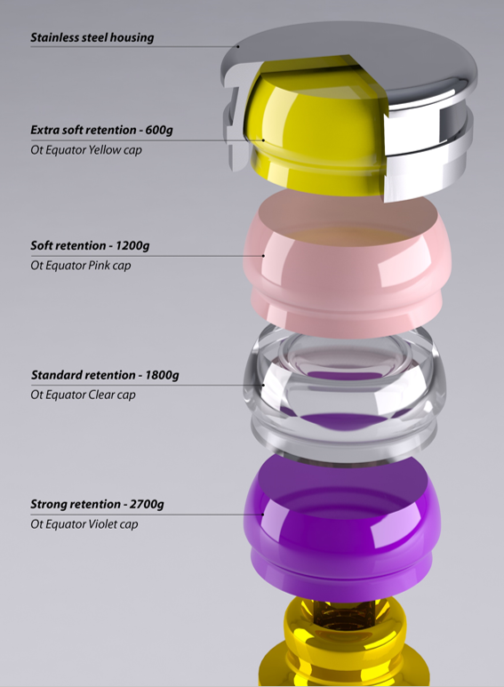
OT Equator: Elastic Caps
Multiple options available to the dentist able to adapt the
dentures retention according to the patient needs.
Each elastic cap offers a 1-year duration time in the mouth
with no need of replacement.
Each elastic cap is counting on the same internal
design and geometry supported by a specific chemical formula
providing the designed elastic functionality.

Slide 7
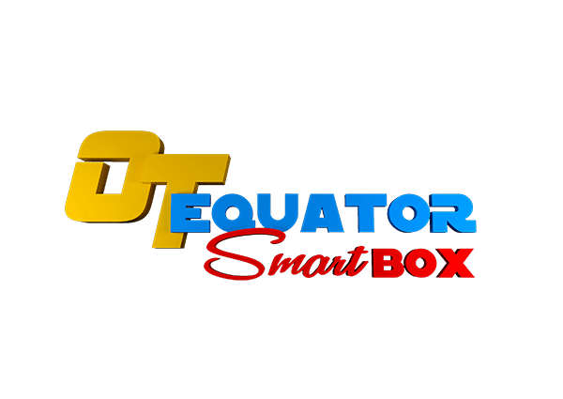
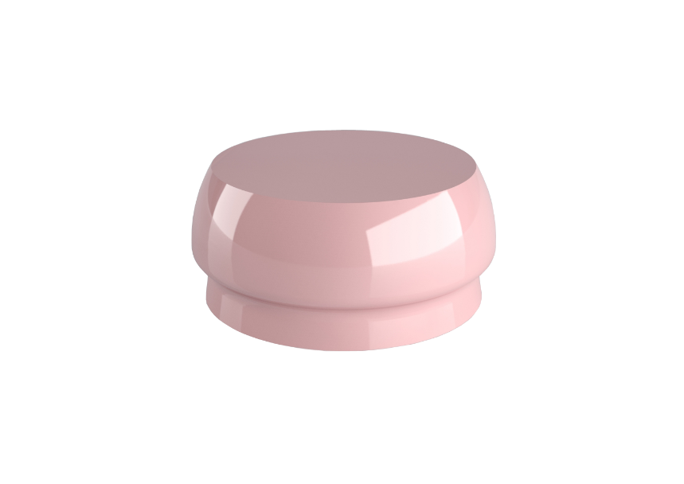
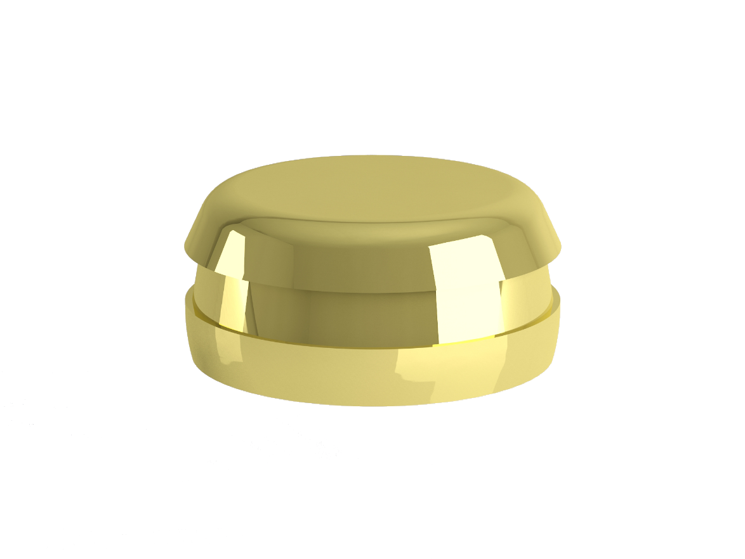
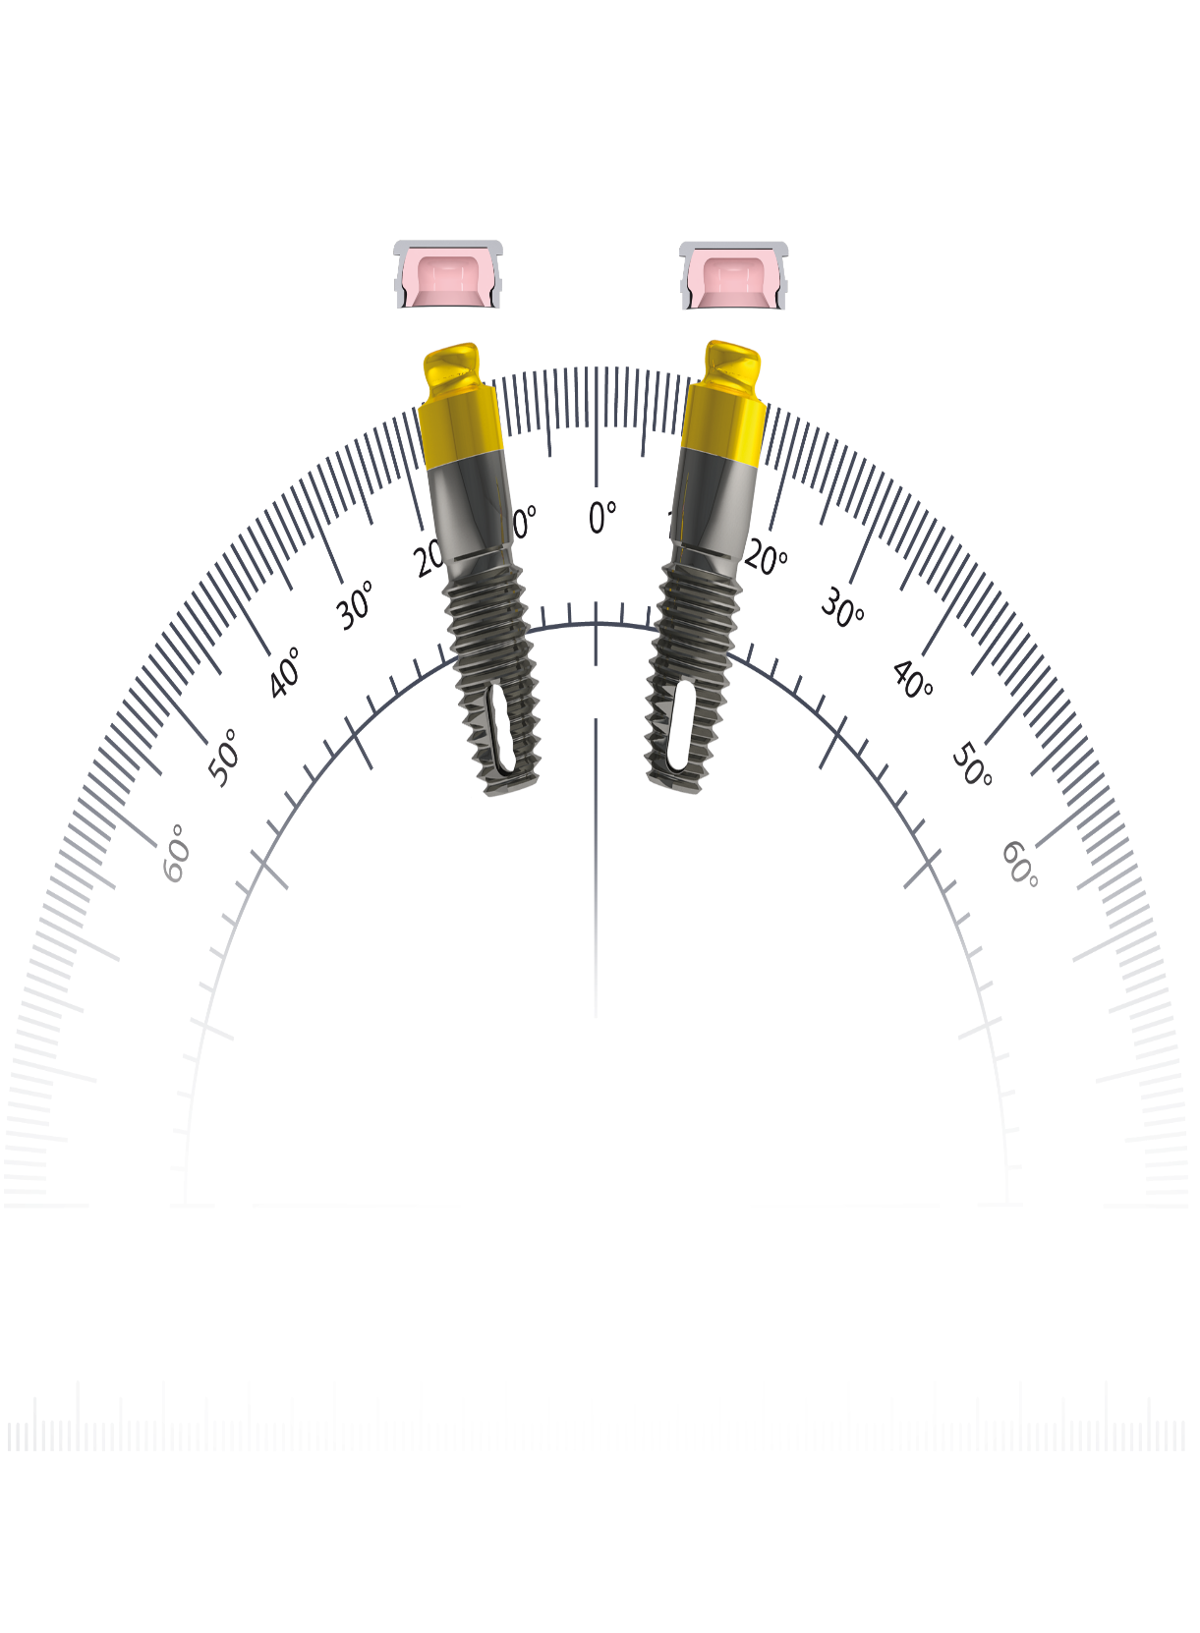
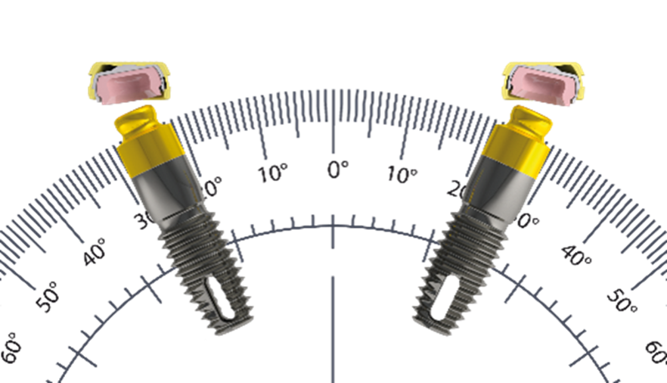
STANDARD METAL HOUSING
SMART BOX HOUSING
Smart Box housing is designed to work with the same
OT Equator elastic caps and attachments reaching up to 50° of implant divergence correction between the dental implants.
OT Equator standard titanium metal housing allow
to correct up to 30° of implant divergence between the dental
implants.

Slide 8
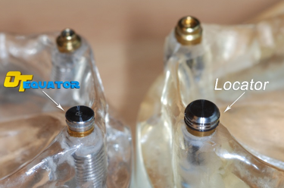
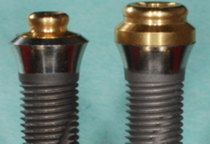
OT Equator: Dimensional Analysis
Ot Equator counts on reduced height and diameter compared
to the standard Locator Type attachment.
Unique fitting for conical implant platforms offering a
superior hygienic standard.

Slide 9
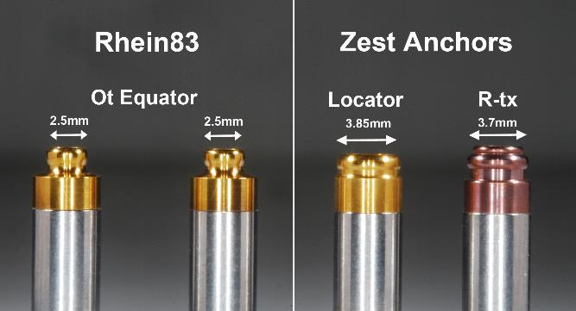
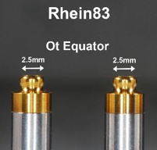
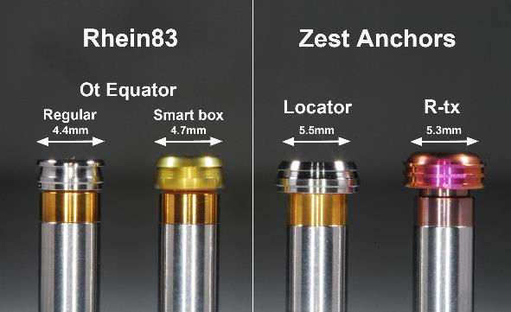
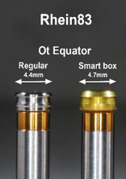
OT Equator: Dimensional Analysis
Overall dimensional advantage:
abutments diameter comparation.
Overall dimensional advantage:
Metal housings diameter comparation including the new Smart Box System.

Slide 10
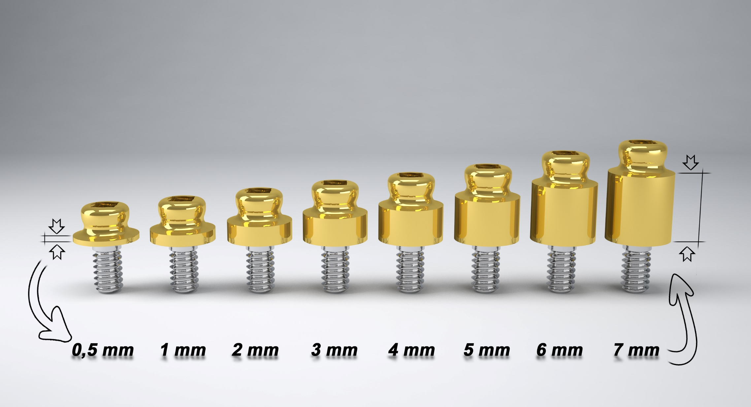
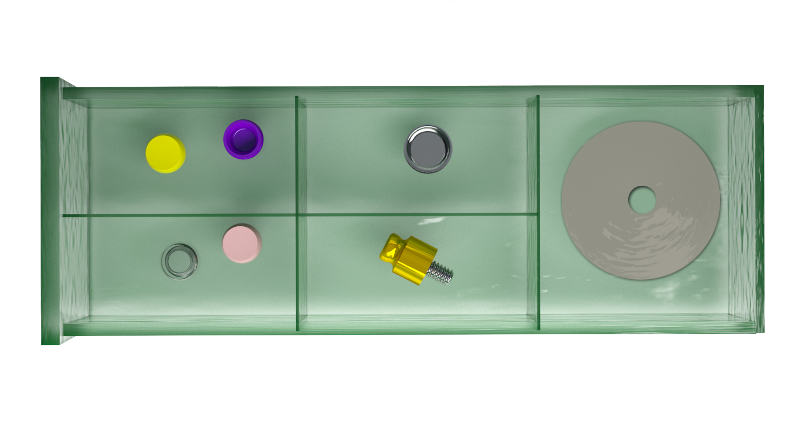
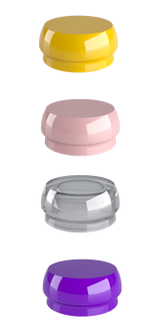
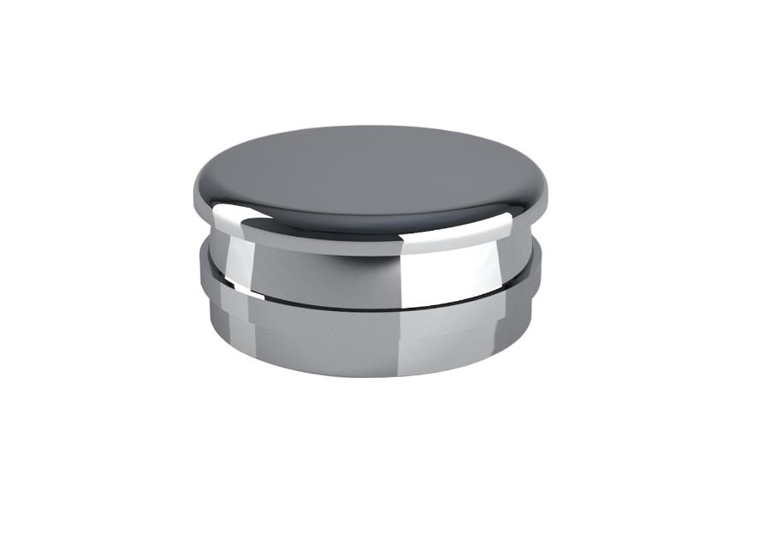
ETKNAT1
ETKNAT2
ETKNAT3
ETKNAT4
OT EQUATOR KIT

Slide 11
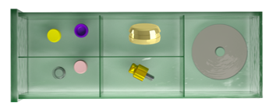
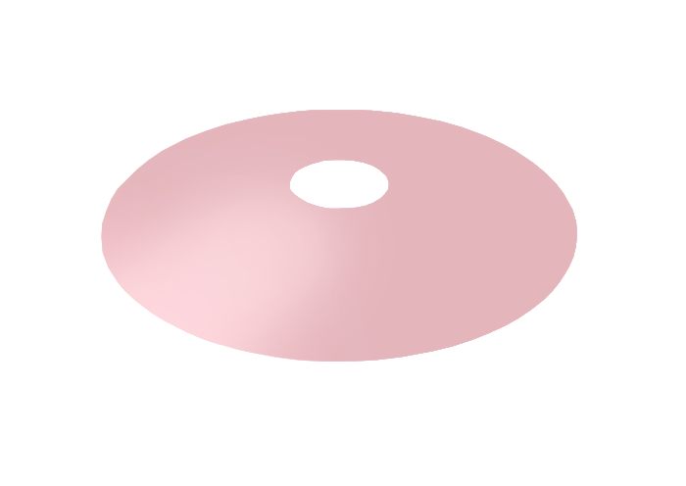
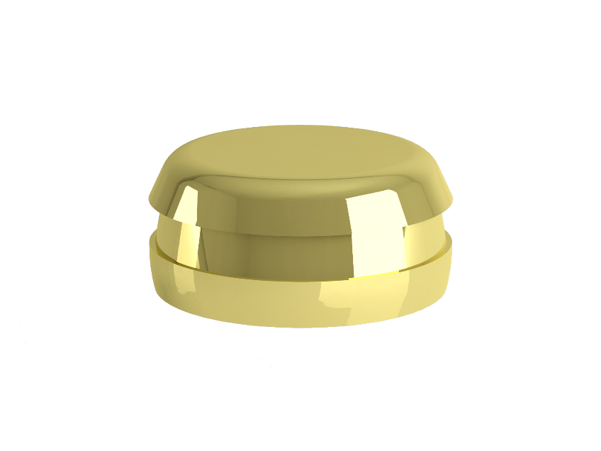
ETKNAT1SB
ETKNAT2SB
ETKNAT3SB
ETKNAT4SB

Slide 12
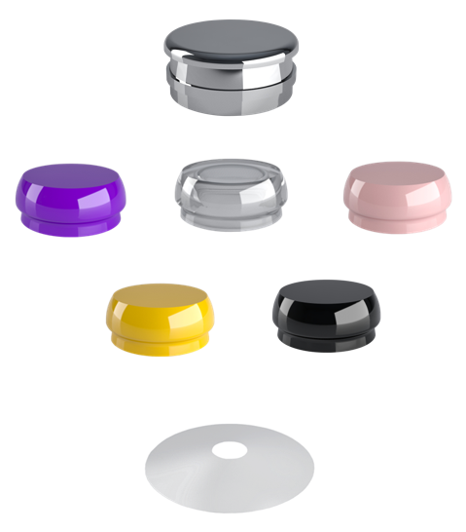
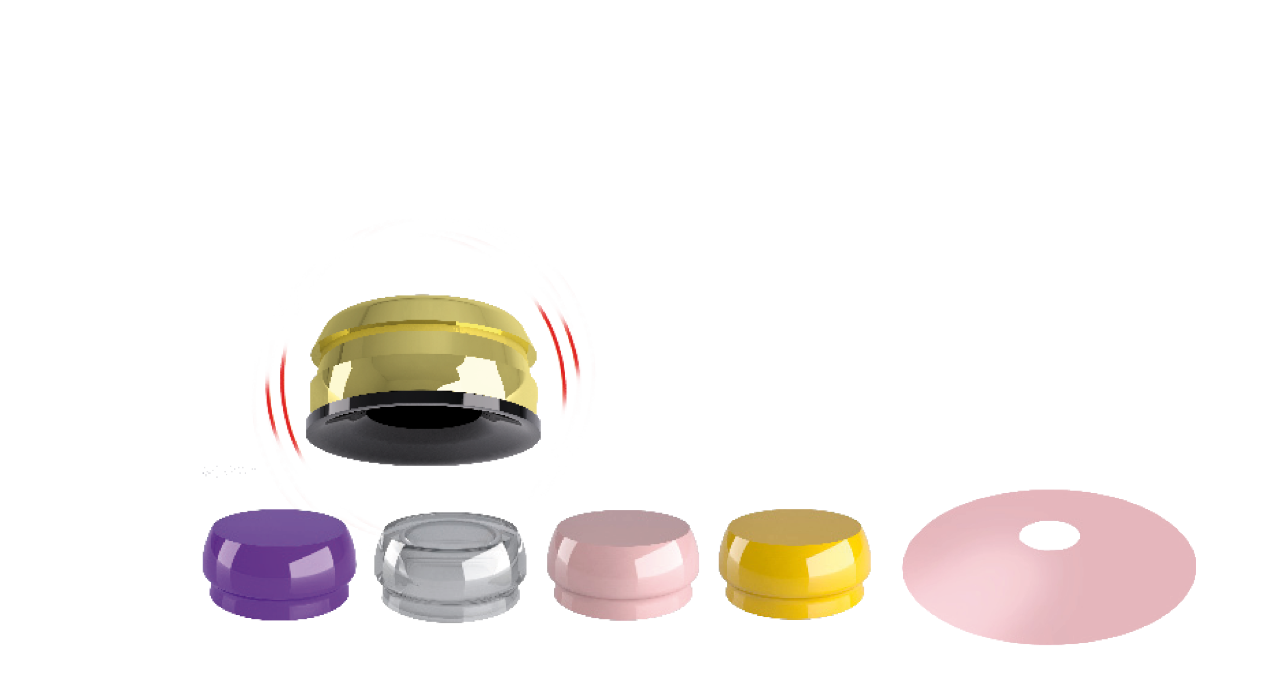
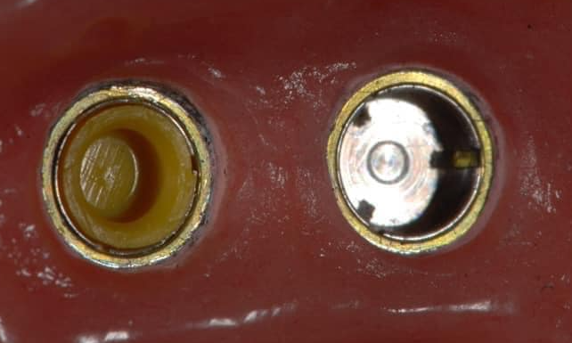
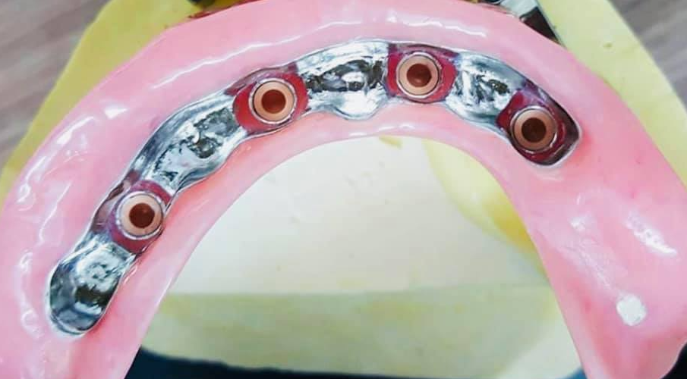
ETK100
ETK101
ETK100
ETK101

Slide 13
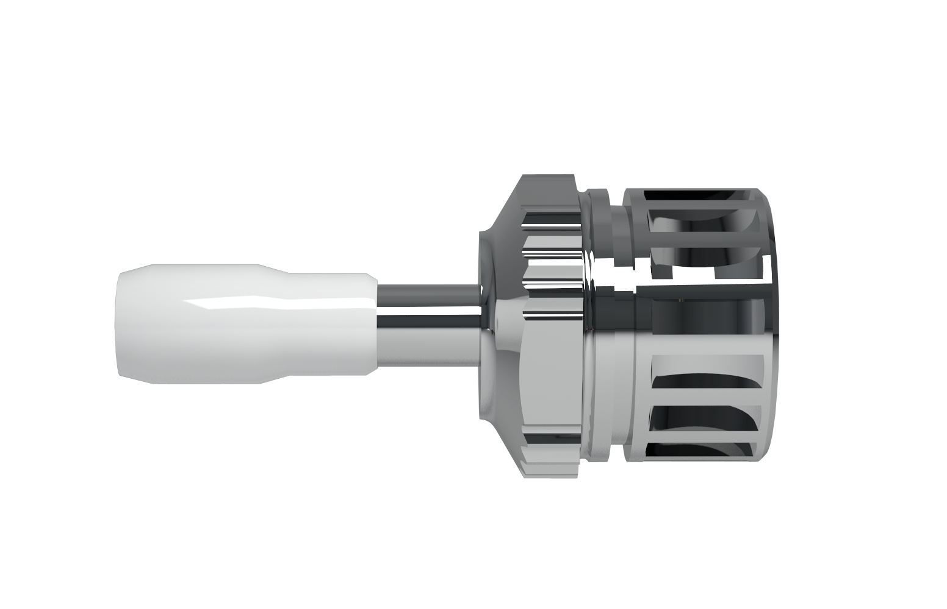
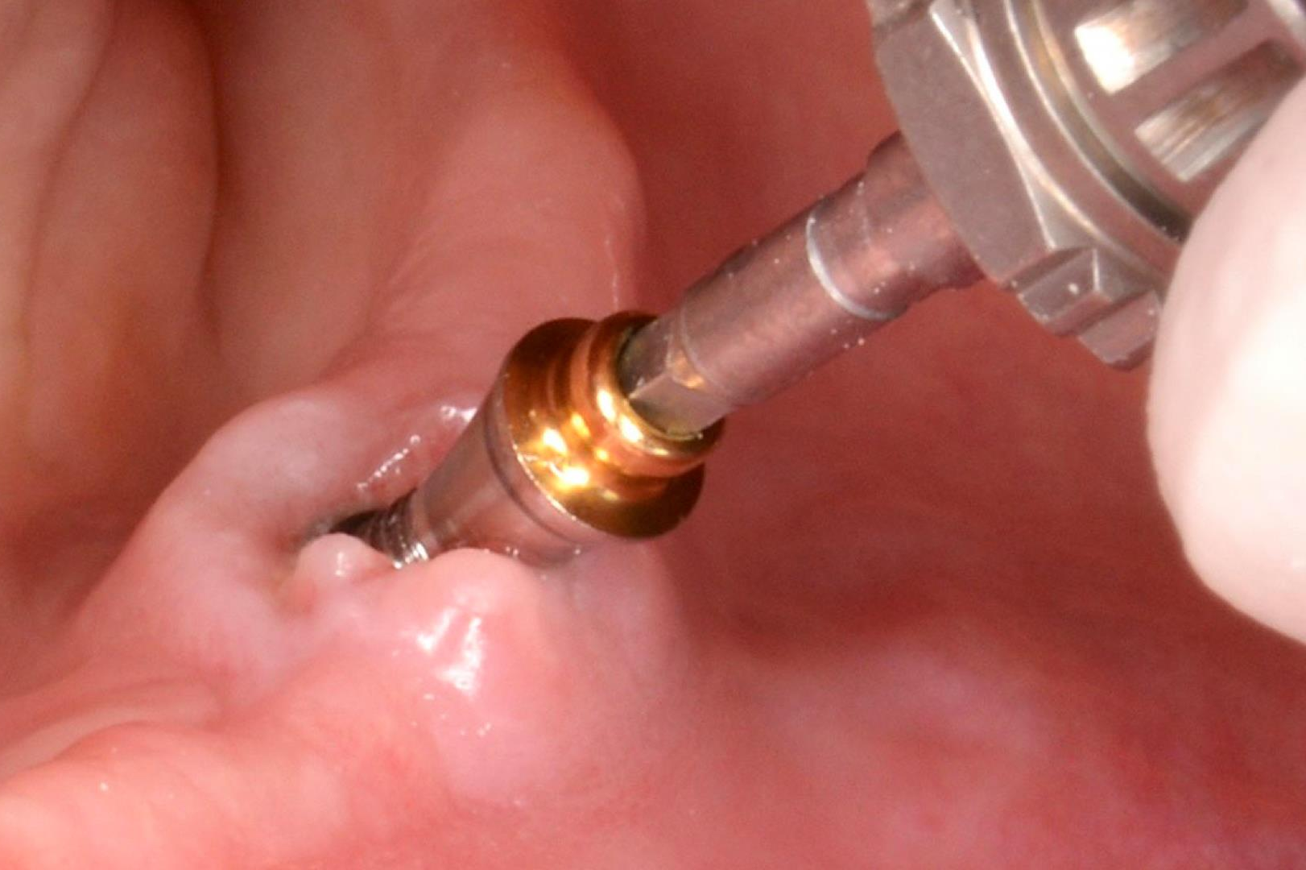
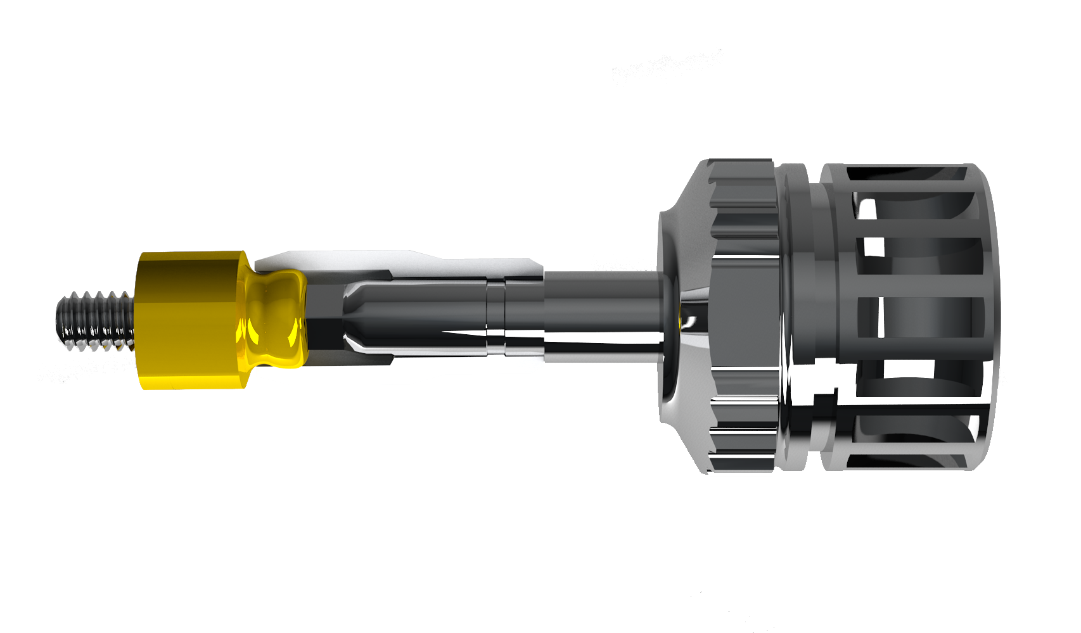
ETK105
SCREW DRIVER

Slide 14
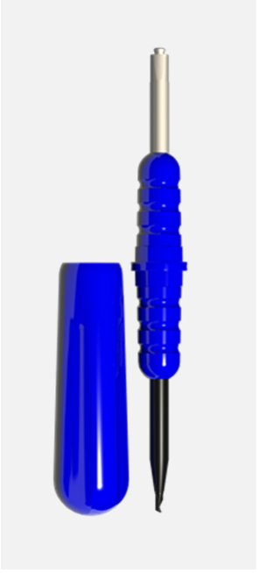
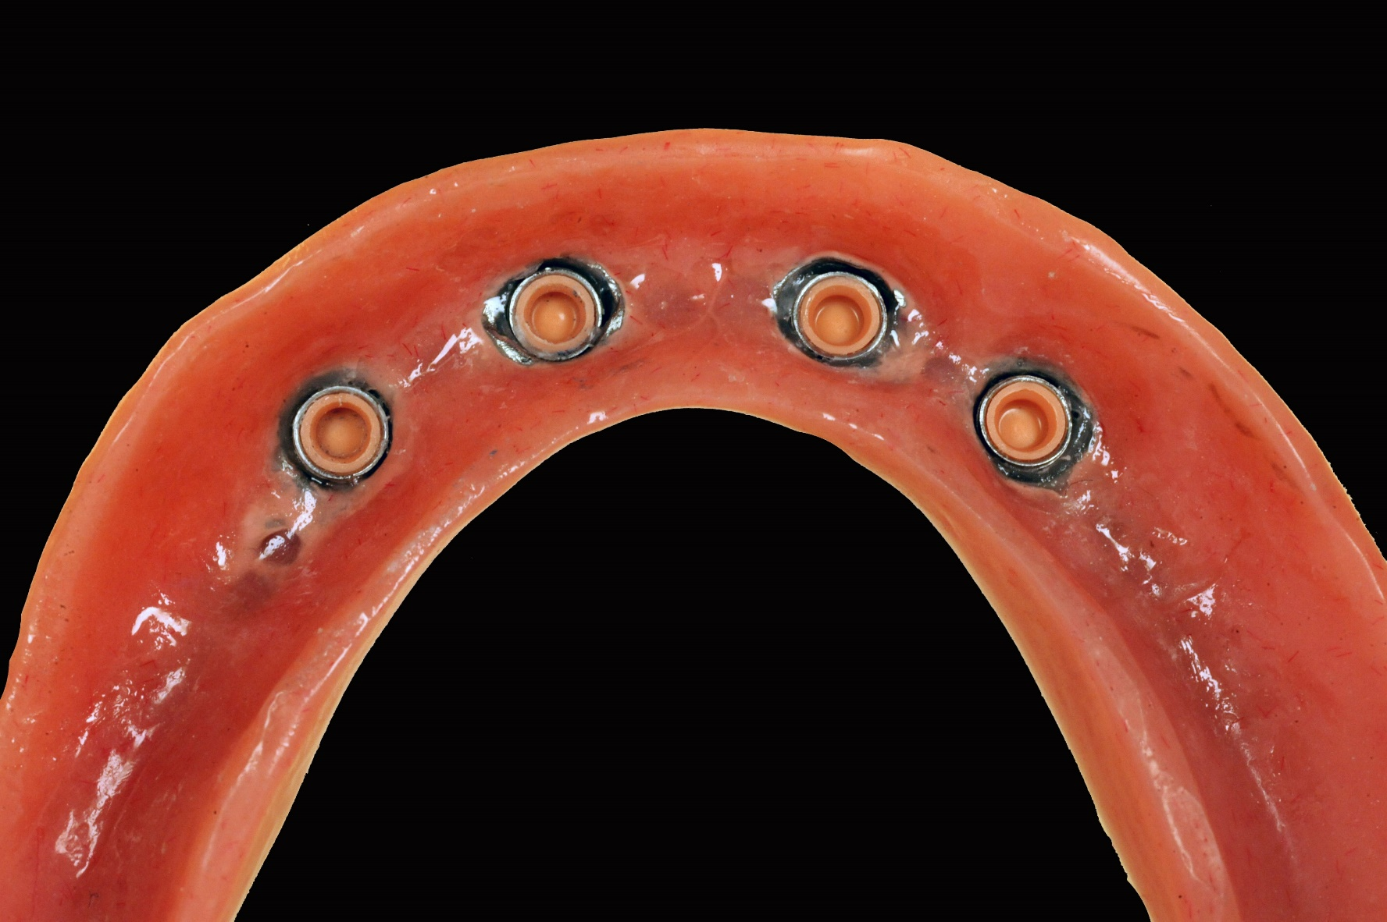
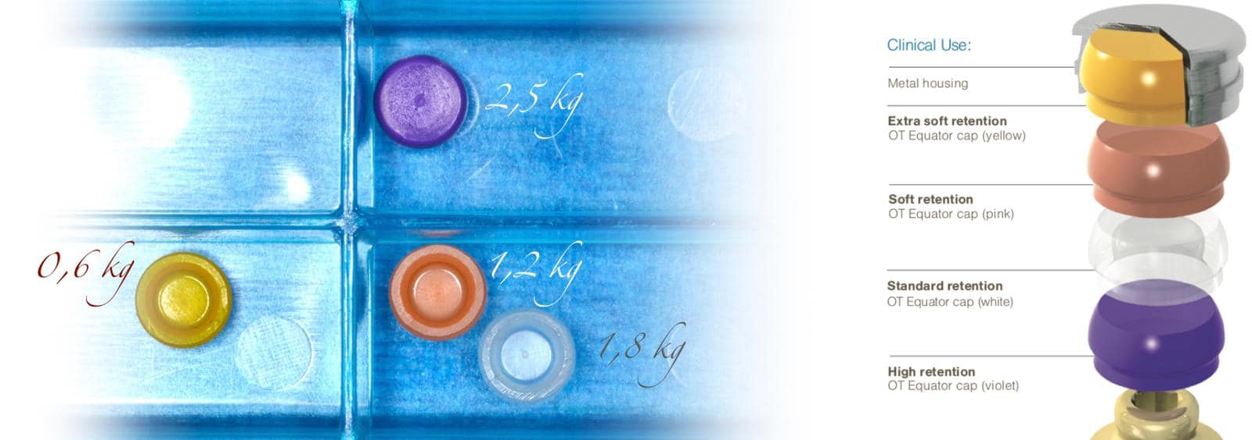
ETK104
INSERTION EXTRACTION TOOL

Slide 15
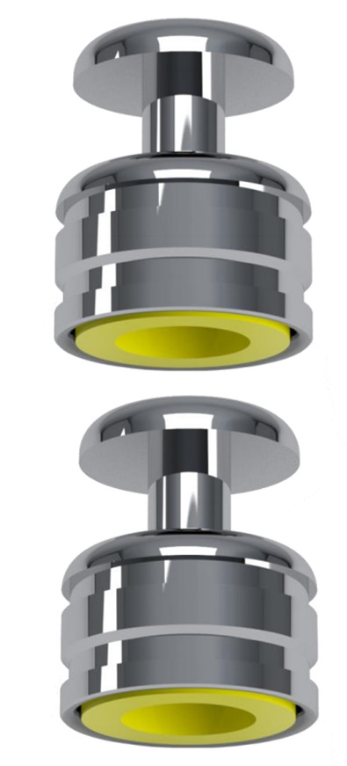
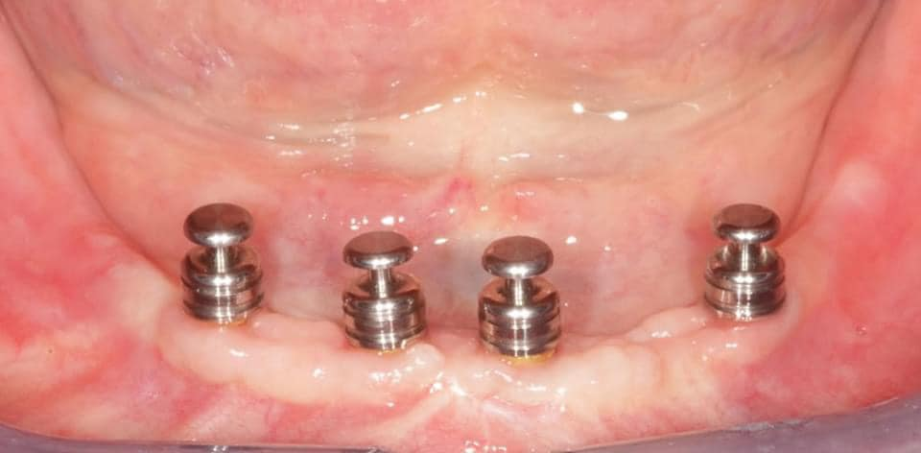
ETK103
IMPRESSION TRANSFERT

Slide 16
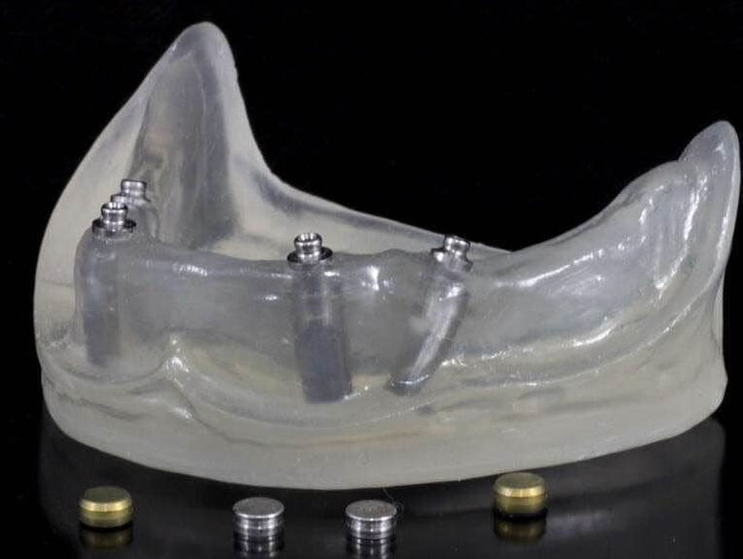
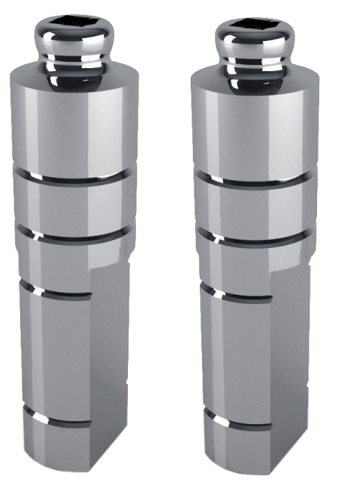
ETK102
LABORATORY ANALOGS

Slide 17
SUPPORT TO OUR PARTNERS
.

Slide 18
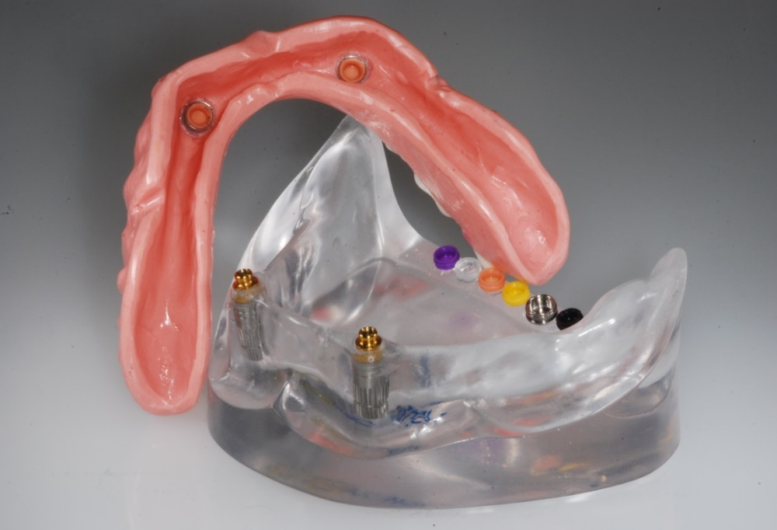
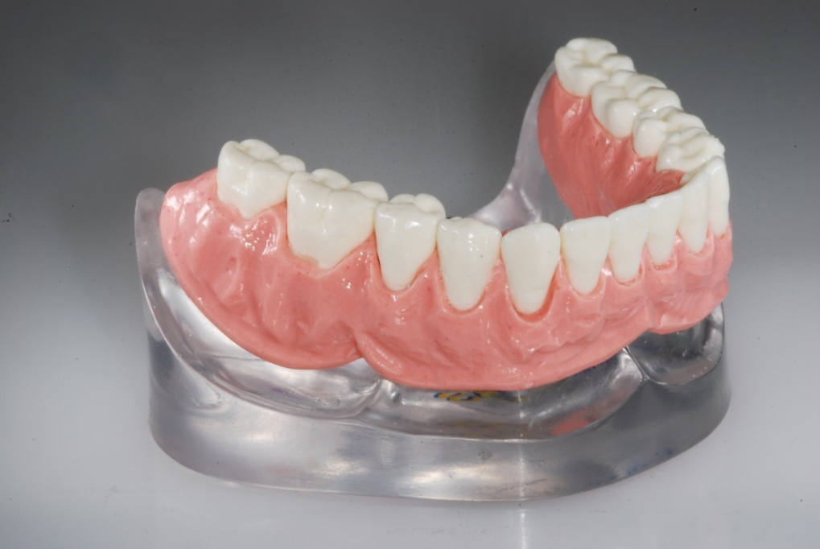
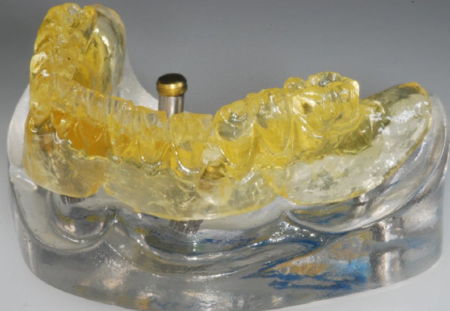
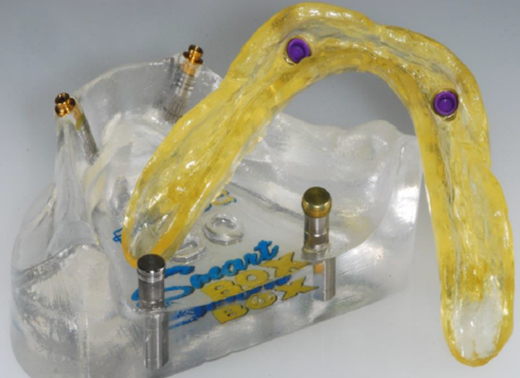
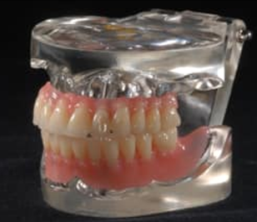
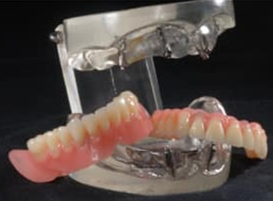
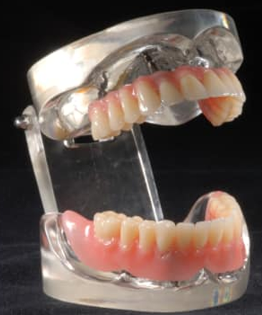
OT EQUATOR
DEMONSTRATIVE MODELS
Personalization options:
Your company logo
Your Implants in the model
Different options in terms
of lower and upper jaws with regular and Smart Box Housings.

Slide 19
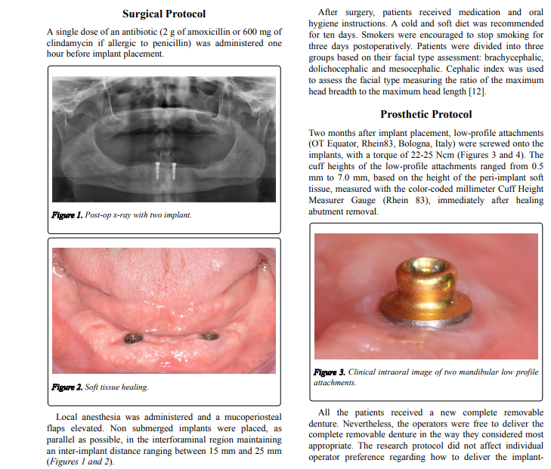
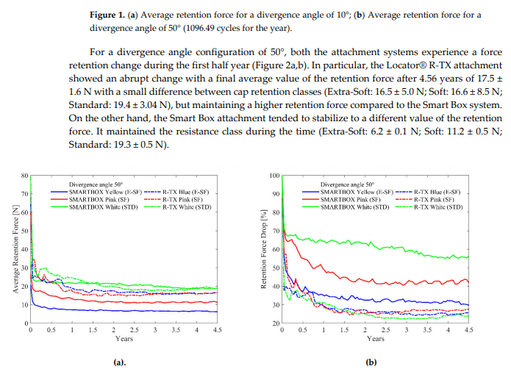
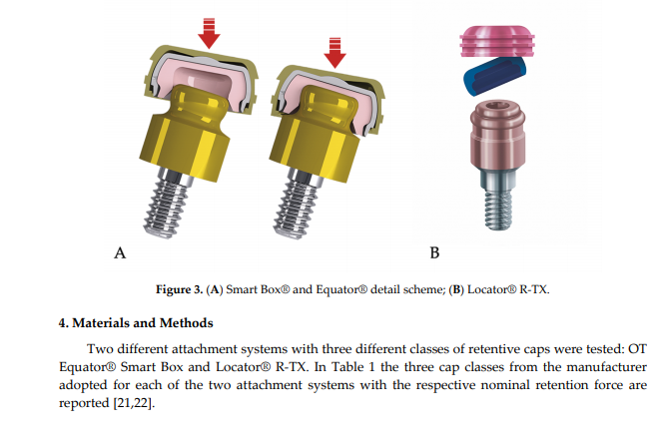
SCIENTIFIC LITERATURE
Clinical Research
University independent reports
Tests reports

Slide 20
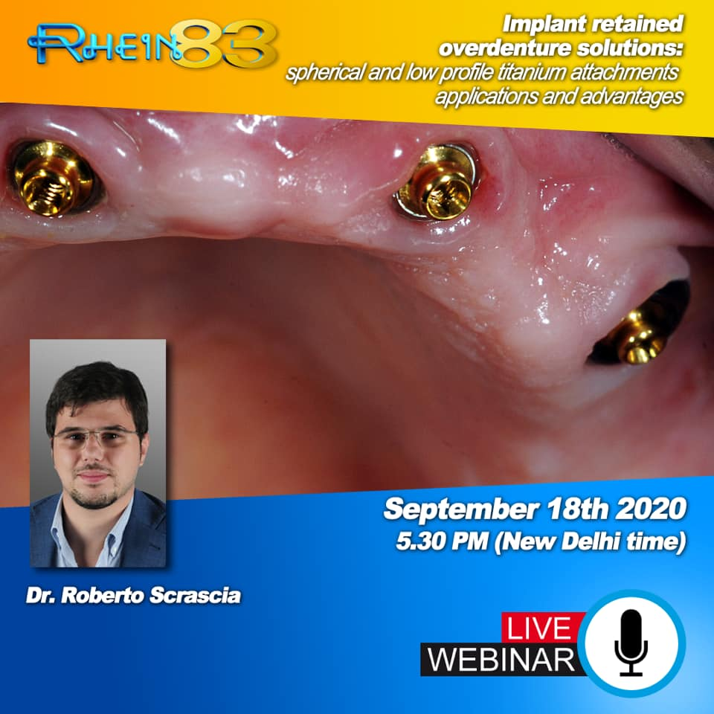
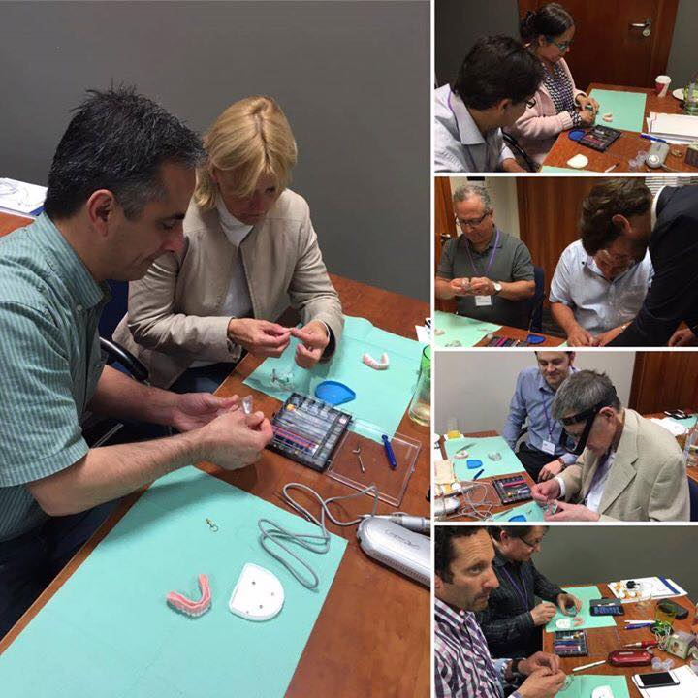
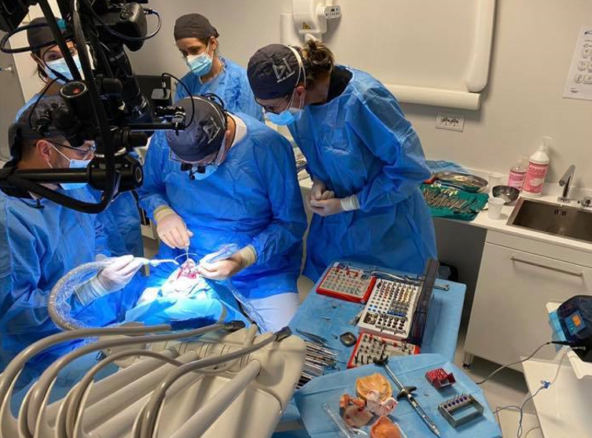
Personalization options:
Web-Training Program
Hands-on courses
Live on patient surgery courses
OT EQUATOR
SCIENTIFIC TRAINING PROGRAM

Slide 21
DIGITAL WORK-FLOW
.

Slide 22
We Create
Quality Professional
PPT Presentation
DIGITAL
WORK-FLOW
Digital work-flow leads to an improved predictability, safety, and efficiency of prosthetically-driven implant dentistry by using computer-assisted, template-based surgery.
In tissue supported and implant retention overdenture, the prosthetic guided surgery is
a key point to insert the implants, the OT Equator attachments, and steel housing to the highest level, inside the prosthetic space.

Slide 23
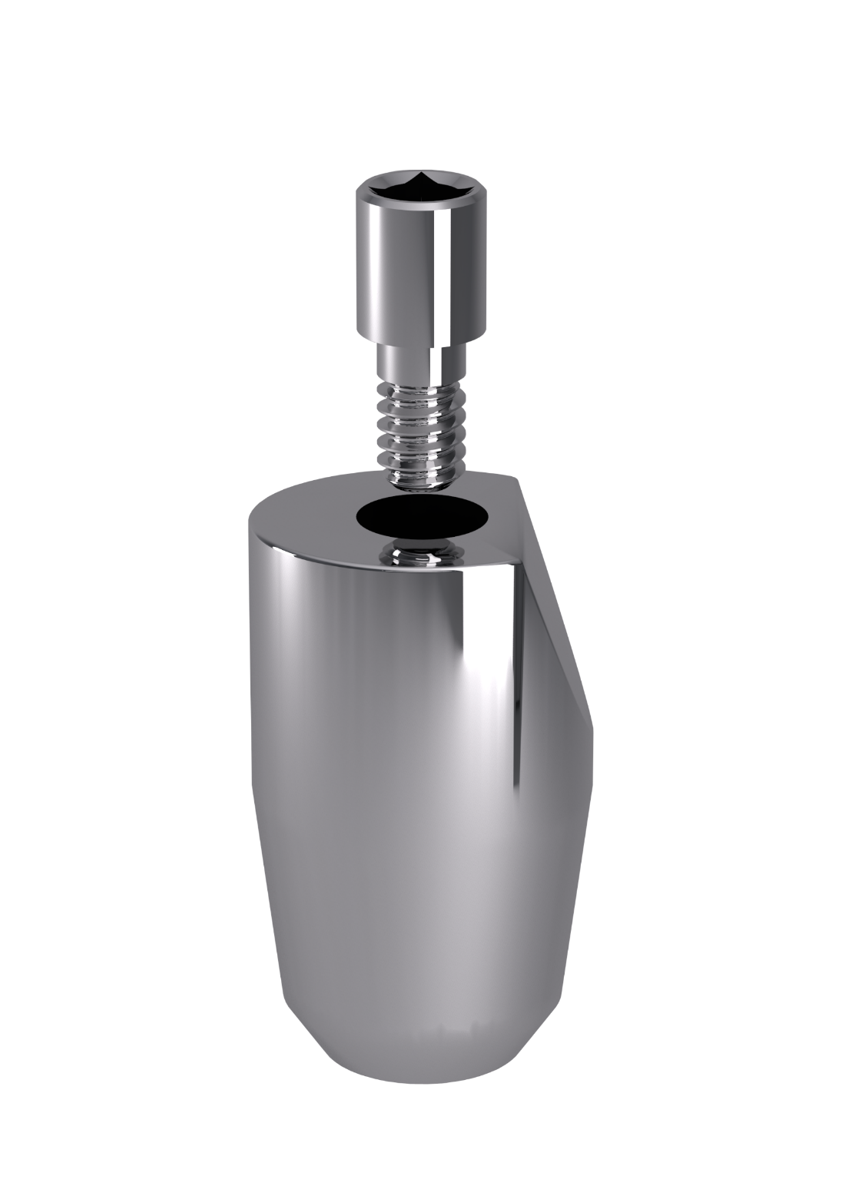
Ot Equator Scan Bodies Files:
Allowing to replicate the exact position of the OT Equator for the cad-software.
Procedures: Direct digital intra-oral scanning, by having the Ot Equator scan abutments
screwed in the patient’s mouth. In alternative the Ot Equator analog components are
screwed to the plaster model allowing to work with the laboratory scanner.

Slide 24
Low profile OT Equator milled attachment:
The smallest dimensional solution counting on reduced height and diameter with a 2,0 mm thread.
Available in all the most important dental software and libraries.

Slide 25
Dimensional Analysis
Ot Equator offers the smallest dimensions also as a milled attachment for bars application.
Prosthetic Project Optimization
Counting on reduced dimensions the aesthetic results will be improved.
Versatility
Ot Equator milled attachments can be used on different
types of materials counting on the same functionality.

Slide 29
www.dogaitek.com

